Slide 1
JAVA
Unit 6(b)

Slide 2
Nested try block
The try block within a try block is known as nested try block in java.

Slide 3
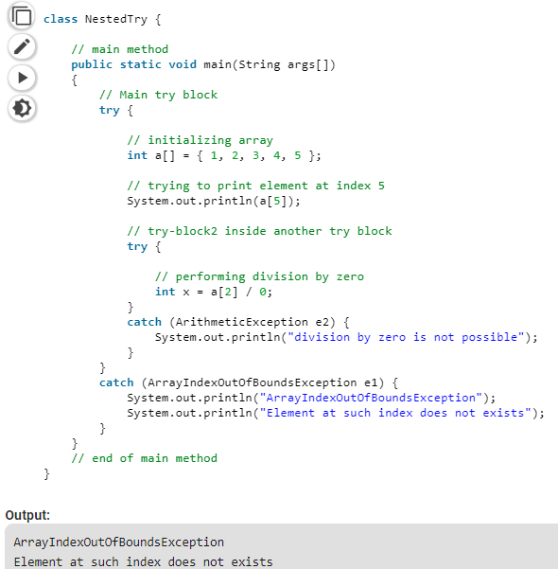

Slide 4
Java throw keyword
The Java throw keyword is used to explicitly throw an exception.
We can throw either checked or unchecked exception in java by throw keyword. The throw keyword is mainly used to throw custom exception.

Slide 5
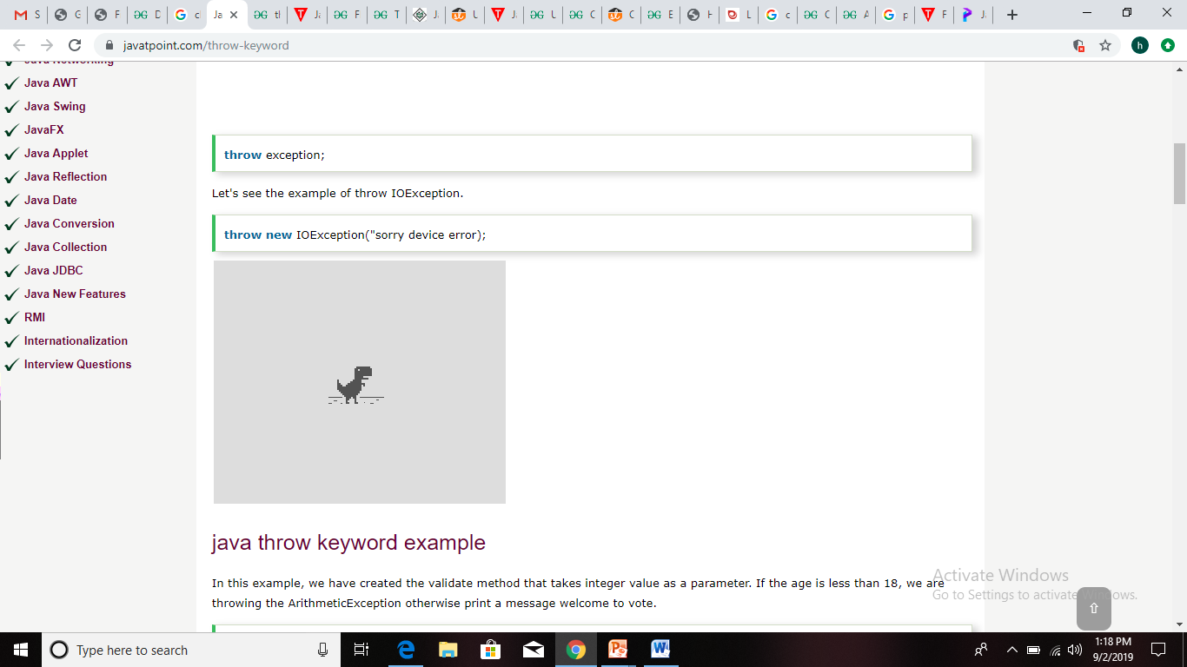
Java throw keyword

Slide 6
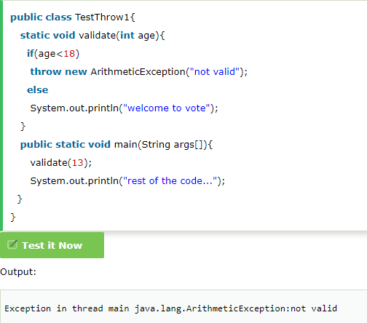
Java throw keyword

Slide 7
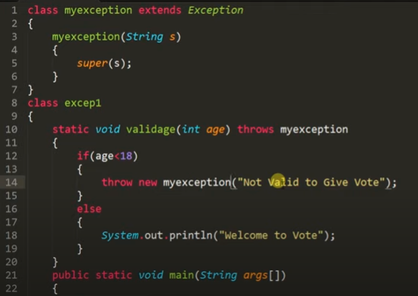
JAVA throw keyword example

Slide 8
Java finally block
Java finally block is a block that is used to execute important code such as closing connection, stream etc.
Java finally block is always executed whether exception is handled or not.
Java finally block follows try or catch block.
Why use java finally: Finally block in java can be used to put "cleanup" code such as closing a file, closing connection etc.
NOTE: For each try block there can be zero or more catch blocks, but only one finally block.

Slide 9
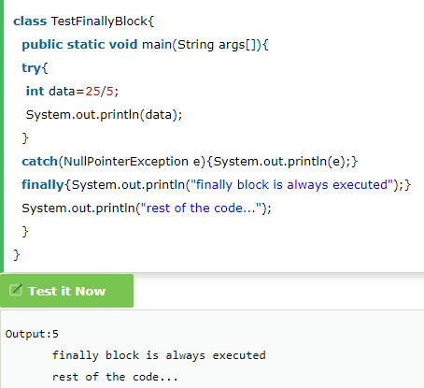
Case 1

Slide 10
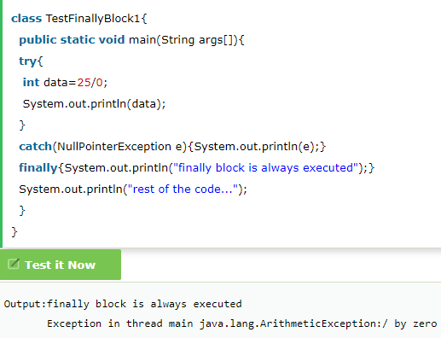
Case 2

Slide 11
built-in exceptions
https://www.geeksforgeeks.org/built-exceptions-java-examples/

Slide 12
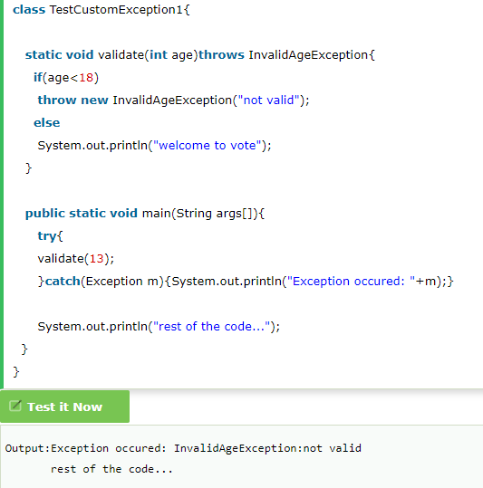
Java Custom Exception

Slide 13
Chained Exception
Assignment qs

